Slide 1
Module 10: Final Project Template
Name: Matt Diamond

Slide 2
Introduction
As part of the final project in Module 10, you are asked to solve a data science problem using all the knowledge and techniques you learned through the program.
You must select a problem you desire to and are able to solve during a period of four weeks. You can use private or public data to solve it.

Slide 3
Final Project Milestones
Module | Milestone | Task
Modules 5-8 | Part 1: Outline Your Project | Prepare a project outline where you: Define the data science problem you want to solve Identify the datasets you plan to use Describe the desired outcomes of the project Please note that you will submit a status of your progress in Module 7
Module 10 (Weeks 1-3) | Part 2: Submit Your Project | Work on the approved project outline and submit: Your code A presentation on your project As you will be required to present your project in Module 10 Week 4, no extensions will be available for final project submission
Module 10 Week 4 | Part 3: Present Your Project | Present your final project to your Learning Facilitator and Mentor Please note that 50 points will be deducted from your Final Project – Part 2 if you don’t complete your presentation
Your Learning Facilitator will guide you, review your submissions, and provide feedback throughout this time.

Slide 4
Project Outline Instructions

Slide 5
Project Outline
Prepare a project outline where you:
Define the data science problem you want to solve
Identify the datasets you plan to use
Describe the desired outcomes of the project
Your project outline will be reviewed by your Learning Facilitator.

Slide 6
Instructions
Before you fill out the project outline template, make sure you:
Read the instructions for the structure of the project
Select a project that can be completed in a period of 4 weeks
Have the permission to use the proposed dataset
Have a clear understanding of what to do to solve the problem you are proposing and the results you want to find
Will be applying the techniques explained in the program You can go further and use different models or methods, but you should be able to understand them and explain them both in the final document and the oral presentation.

Slide 7
Basic Structure of the Project
You can use this structure to create your project presentation:
Title
Abstract
Introduction
The problem (context)
Purpose of the study
Project description
Hypothesis
Workflow
Methods
Analysis
Results
Implementation (optional)
Conclusion

Slide 8
Workflow Specification
Here’s the workflow specification based on the problem-solving framework:
Define the problem
Map the system
Define suitable metrics
Select modeling tools
Implement model
Evaluate model
Deploy the final model

Slide 9
Final Project Part 1: Outline Your Project
Equity Markets Amid COVID-19: How Can Consumer Discretionary Stock Prices be Predicted During a Pandemic?

Slide 10
Proposed Title of the Project
Enter the proposed title of your project in the field below.
Equity Markets Amid COVID-19: How Can Consumer Discretionary Stock Prices be Predicted During a Pandemic?
*Please add slides as required.

Slide 11
Outline of the Project
Outline your project in the field below. Define the data science problem you want to solve and the approach you will use to solve it.
My project’s goal is to apply data science in order to predict the trajectory of consumer discretionary stocks amid COVID-19.
I plan to approach the problem with a two-pronged approach: 1) measure the relationship between both consumer spending behavior based on publicly available consumer sentiment and consumer spending data and consumer discretionary stock price movements, and 2) measure the same relationship between payment card spending data and the aforementioned stock price movements.
*Please add slides as required.

Slide 12
Justification of the Project
Describe why the project is important to you, your company, or society.
The project holds weight with me because I’d like to improve the accuracy of equity market forecasts available to individual investors. Despite a raft of computing technology, unstructured data and liquidity, many retail (i.e., non-institutional, non-professional) investors lack the insight to make intuitively actionable & sensible investment decisions; I’d like to help solve this problem and decrease the inherent uncertainty of equity investment.
*Please add slides as required.

Slide 13
Datasets
What datasets will you use? Do you have the permission to use them?
I plan to use the datasets available to financial market professionals
World Health Organization (COVID-19 cases; publicly available)
Bloomberg (permission will be granted by JPMorgan, my employer)
University of Michigan Consumer Sentiment (publicly available)
Federal Reserve Bank of St. Louis Consumer Spending Data (publicly available)
*Please add slides as required.

Slide 14
Desired Outcomes
What are your desired outcomes from the project?
I would like to establish an intuitively actionable, data-driven foundation to predict consumer spending behavior and forecast justifiable equity market performance based on my fundamental analysis. Put more simply, I’d like to use data science to more easily separate signal from noise in the equity market.
*Please add slides as required.

Slide 15
Project Outline: Check-in

Slide 16
Project Outline: Check-in
Hopefully, you have identified the data science problem you want to solve and made some progress on your project outline by now.
If you have any questions about the final project, please reach out to your Learning Facilitator during your next office hours session.

Slide 17
Project Outline Check-in
In the field below, list all the items you have completed so far.
Identified data sources and migrated to Jupyter notebook for EDA
Performed EDA on initial datasets
Narrowed timeframe of consideration for examining equity valuations and consumer behavior (2010 – 2020) on which my model’s predictions will be based
I plan to perform initial statistical analyses on datasets this coming weekend and develop an initial iteration of my predictive model
*Please add slides as required.

Slide 18
Final Project Part 2: Project Presentation
Equity Market Rationality Amid COVID-19: Can Consumer Discretionary Stocks be Priced Predictably During a Pandemic?

Slide 19
Abstract
Introduction & Methodology
I determined the best data series to explain movements in consumer discretionary equities as COVID-19 took hold in the US
I used a linear regression approach to synthesize data and to generate predictions
Data Collection & Analysis
Information from multiple sources formed a five-fold dataset: Consumer Sentiment, Personal Consumption, COVID-19 Case Counts, Payment Card Spending Growth, and Stock Price Movements
Data cleaning and linear interpolation played an integral role in model creation
Recursive Feature Elimination determined the best explanatory factors for stock price movements
Results &
Conclusions
Consumer discretionary stock prices are best explained by payment card data, albeit to an indeterminate degree
The model’s utility could improve in upcoming months as more recent sentiment and consumption data are made available

Slide 20
Introduction
Problem-Solving Framework
Consumer discretionary stock price movements were predicted using payment card transaction data, consumer sentiment & personal consumption info and COVID-19 case data
Linear regression and coefficients of determination were used to construct a predictive model of stock price movements
Data were collected from public and private databases
Workflow Model
Stock price, consumer sentiment and consumption, payment card spending and COVID-19 case information were aggregated
A suitable metric was the difference between predicted and actual stock prices in April 2020
Modeling tools included linear regression and recursive feature elimination
Processes Used to Solve Problem
A RFE-suggested linear regression model was implemented to predict stock price movements
Linear regression models separately featuring consumer sentiment and personal consumption, payment card spending data and COVID-19 cases were used to compare coefficients of determination among the three variable groups.

Slide 21

The Problem (Context)
Retail (non-professional) investors lack tools and sophistication of investment professionals, leading to sub-optimal investment returns during COVID-19
Average 401(k) balance down -19% in through April 2020*
I used data science to offer a predictable guide to price movements in consumer discretionary stocks amidst the COVID-19 pandemic
Individual investors could have a clearer understanding of stock price movements during COVID-19, potentially reducing the inherent uncertainty of equity investment
*Source: Fidelity Investments (https://www.fool.com/investing/2020/04/28/heres-the-impact-of-covid-19-on-the-average-americ.aspx)

Slide 22

Purpose of the Study
What I hoped to achieve from analysis: make the little guy smarter
Simply put, I wanted to provide individual, non-professional investors with a predictive measure of consumer discretionary stocks as the US economy emerges from a COVID-19-induced lockdown

Slide 23





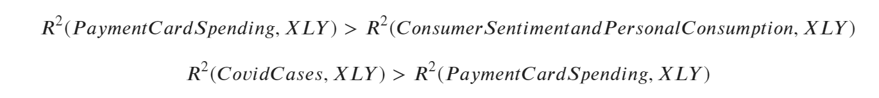
Project Description: Hypothesis
Are Consumer Discretionary Stocks Best Predicted by Sentiment and General Consumption, by Payment Card Transactions, or by COVID-19 cases?
To answer this question, I collected data from five different sources:
I hypothesized the following relationships among these data sources:
*Please add slides as required.

Slide 24
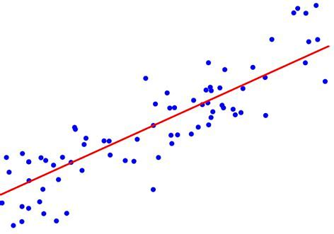
Project Description: Workflow
What data did I focus on?
What analysis did I run?
1. University of Michigan Consumer Sentiment Index
2. Personal Consumption Expenditure (excluding food & energy)
3. Year-on-year payment card spending growth
4. United States COVID-19 case counts
5. XLY (consumer discretionary stock) equity price movement
Linear Regression

Slide 25


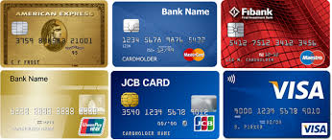

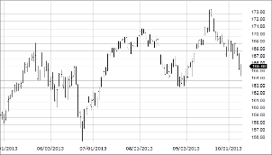
Project Description: Workflow
Consumer Sentiment Data
`
Personal Consumption Data
Payment Card Spending Data
COVID-19 Case Data
Consumer Discretionary Stock Price Data
Data Source | University of Michigan Consumer Sentiment Index | Federal Reserve Bank of St. Louis | Bloomberg | World Health Organization Database | Wall Street Journal Markets
Key Attributes | Monthly index Aggregate score of 50 questions | Monthly entry Specifies consumption of goods and of all goods & services excluding food & energy | Monthly entry Year-on-year spending growth in disparate consumer categories (e.g., clothing, restaurants) | Daily entry Daily and cumulative case counts in the United States | Daily closing prices
Cleaning | Reformat dates to datetimes Linear interpolation of monthly data to daily values | Reformat dates to date times Linear interpolation of monthly data to daily values | Transposition of dataframe Linear interpolation of monthly data to daily values | Filtering for United States cases | Reformat dates to date times

Slide 26
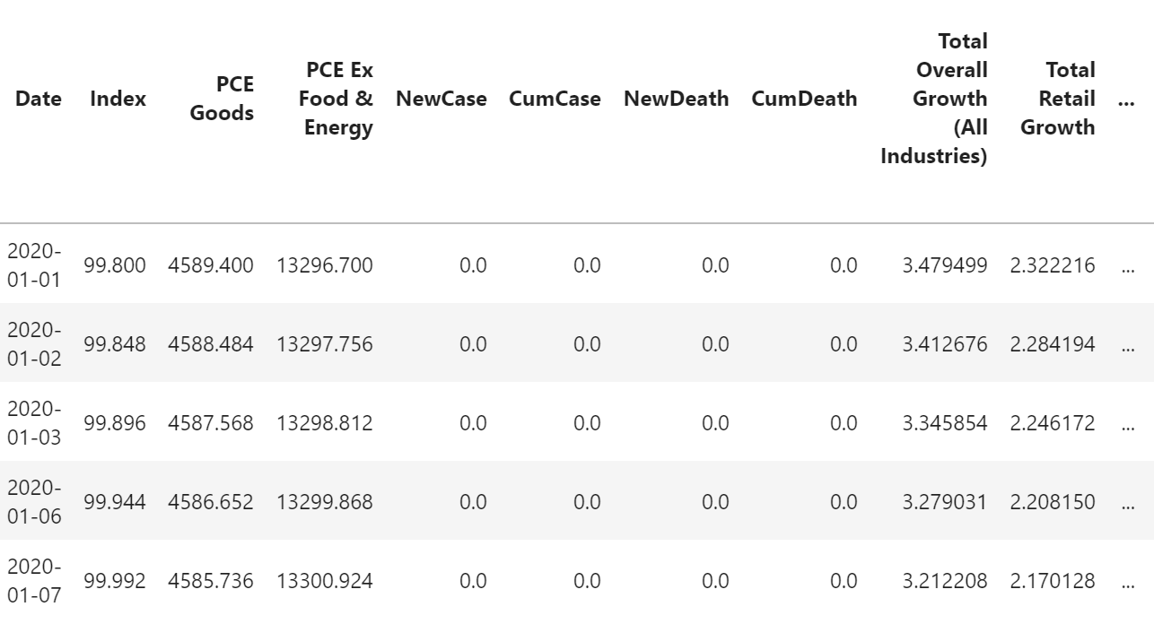
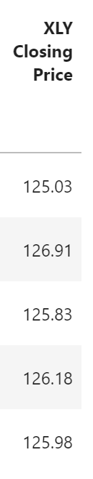
Project Description: Workflow
Data Overview
Consumer Sentiment Index Data
`
Personal Consumption Data
Payment Card Spending Data
Consumer Discretionary Stock Price Data
COVID-19 Case Data

Slide 27
Project Description: Workflow
Decide on regression model
Linear Regression
What type of learning?
Recursive Feature Elimination

Slide 28
Project Description: Workflow
Models
Prep
Split data into training and test sets (80% training, 20% test)
Done using fixed seed
Model used
Linear Regression
Machine Learning models not feasible for use given continuous data (e.g., stock prices)

Slide 29
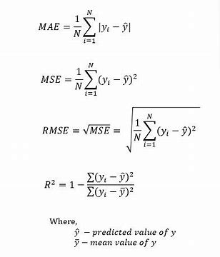
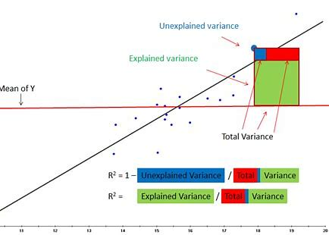
Project Description: Methods
R-squared was used in conjunction with Mean Absolute Error (MAE), Mean Squared Error (MSE), and Root Mean Squared Error (RMSE) to determine the model’s effectiveness

Slide 30
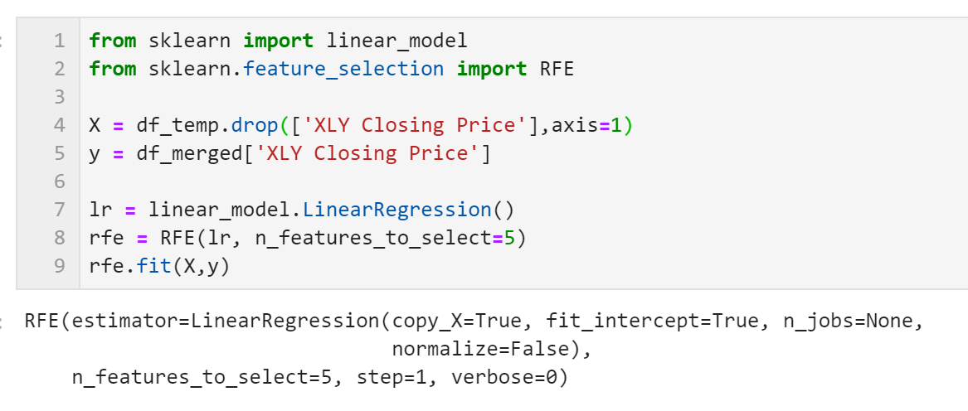
Project Description: Analysis
Using Recursive Feature Elimination (RFE)
In Python, the RFE module performs this process
I generated multiple sets of parameters, starting with 10 and ultimately narrowing to five to maximize R²

Slide 31
Project Description: Results
Independent Variables | R² | Mean Absolute Error (MAE) | Mean Squared Error (MSE) | Root Mean Squared Error (RMSE)
Consumer Sentiment, Personal Consumption | 0.83 | 5.45 | 39.43 | 6.27
Payment Card Spending | 0.90 | 3.64 | 22.13 | 4.70
COVID-19 Cases | 0.84 | 4.95 | 36.04 | 6.00
Payment Card Spending performed best across the board…
….however, COVID-19 Cases’ R² did not exceed that of Payment Card Spending
Hypotheses Affirmed
Affirmed:
Rejected:
Model validation still needed with more recent Consumer Sentiment, Personal Consumption and Payment Card Spending data

Slide 32
Conclusion
Payment card spending data better predict stock prices than do consumer sentiment and personal consumption measures provided to the general public
Model validation with more recent data awaits
Next steps: refine model with more robust spending data (e.g., credit card transactions from JPMorgan Chase), incorporate more recent economic and spending data when available
Potential Improvements
Data
Model
Detailed measures of consumer sentiment (e.g, concerning personal financial situations) More robust payment card spending data (e.g., daily transactions—eliminating the need for linear interpolation to capture intra-month changes)
Incorporating better data RFE algorithm will select more predictive features with better data, longer time series

Slide 33
Bibliography
University of Michigan Consumer Sentiment Index: https://data.sca.isr.umich.edu/
Federal Reserve Bank of St. Louis: https://research.stlouisfed.org/ssi/search.php?q=personal%20consumption%20expenditure%20monthly
COVID-19 Cases: https://data.humdata.org/dataset/novel-coronavirus-2019-ncov-cases
*Please add slides as required.

